Slide 1

CSE101 C Programing
Lecture #0
The kick start session

Slide 2
Course details
LTP – 3 0 0 [Three lectures/week]
Course communication mode
cse101@lpu.co.in
Text Book
C How To Program by Paul Deitel and Harvey Deitel, Prentice Hall of India, 7th Edition, (2013)

Slide 3
Course Assessment Model
Marks break up
Attendance 5
E-WorkBook Evaluation (2 out of 3) 20
MTE 25
ETE 50
Total 100

Slide 4
Acknowledgements
The Khan Academy
EdX
Coursera
programmingsimplified.com
cprogramming.com
learn-c.org
Above all…
Common Sense

Slide 5
The course contents
Introduction to computer organization
Evolution of Operating Systems
Data Types & Operators
Control Structures
User defined functions
Storage classes
Arrays and Strings
Pointers
Dynamic memory allocation
Derived data types – Structures & Unions
File handling

Slide 6

The hitch…
The three BURNING questions in mind…
Why are we learning C language?
What would we do with it, we are engineers?
What will be the course outcome?

Slide 7

Let us re-invent ourselves
To begin with basics…
Let us go to basics.
Let us begin from toddling to learn to walk
Get ready to be childish….

Slide 8

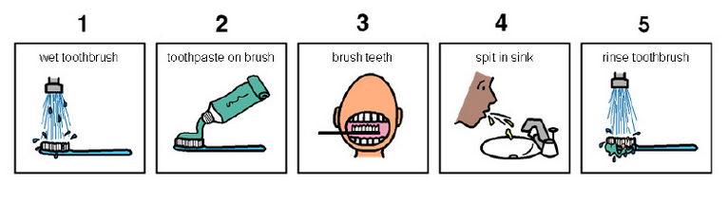
Daily routine
Let us look around our daily routine…
Let us see where all we do programming everyday
Simple things we do to start the day
This too has a set procedure. One follows particular steps to accomplish the task.
So there is ONE program you know which is there in you…

Slide 9
Daily routine
There is a set procedure
Each step is defined
The occurrence is ordered
Jump is NOT permitted
A step cannot be skipped
Start
Pick Brush
Rinse Brush
Apply Paste
Brush
Rinse Mouth
Rinse Brush
Stop

Slide 10


Daily routine
Let us explore more as the day goes by…
Going for a morning 0900 AM Class
Going for a movie at 0900 AM
It is all about WHICH program is loaded WHEN

Slide 11


Daily routine
The flow changes
Start
Go!!!
Where
To
Go?
Class
Movie
Stop
Stop

Slide 12

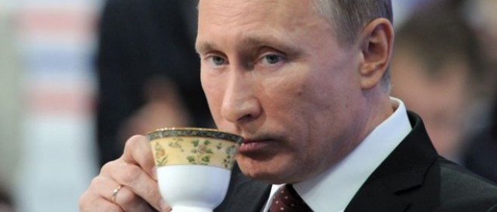




Daily routine
Yet another example but more complex
Vision
Sensor
Sipping TEA
Smell
Sensor
Radiation
Sensor
If all sensors
$$=$$
SIP
If even one is
$$=$$
Touch
Sensor
WAIT!!!

Slide 13




So what does this mean?
Take ANY activity of the day…
It will have a set procedure
It has to be done in a designate way
If not done the specified way will yield wrong results
Success in doing it depends on how closer one is to the prescribed method
This clearly shows that everything has a
Logic

Slide 14

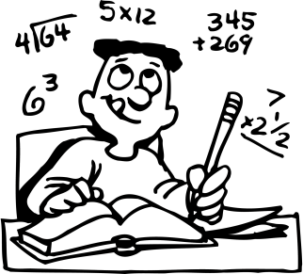
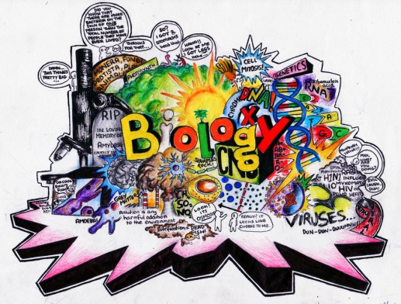





Logic, logic and logic
Logic

Slide 15
What next?
If there is logic in anything and everything
There has to be ways to represent logic
There has to be modes to modify and re-represent logic
There should be methodology to implement and re-design logic
And for all this…

Slide 16


What next?
There has to be logic machine to assimilate, understand, solve, store, retrieve and represent logic
There has to be a LANGUAGE to communicate with the logic machine
Otherwise….

Slide 17

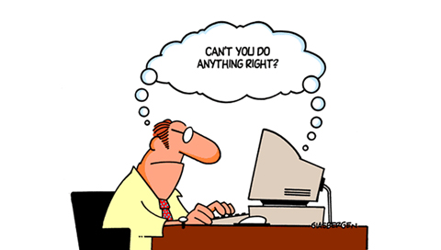


Diving deeper…
How do I roll another rod with a rolling rod??

Slide 18



Diving deeper…
How do I roll another rod with a rolling rod??
A program written in C language with LOGIC

Slide 19


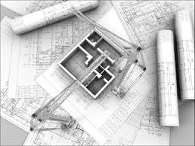
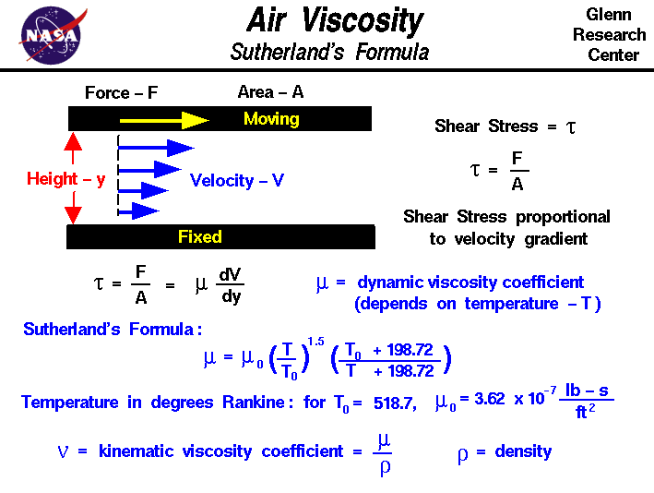
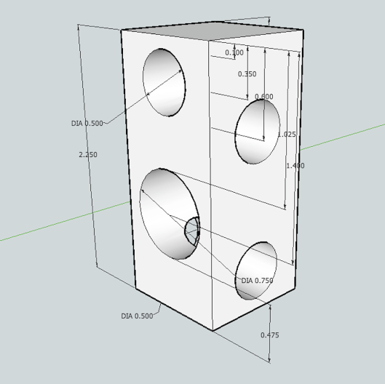


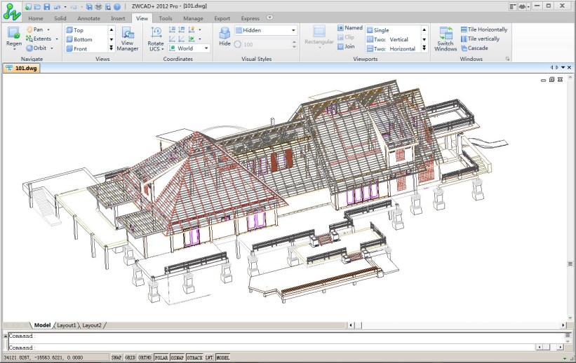
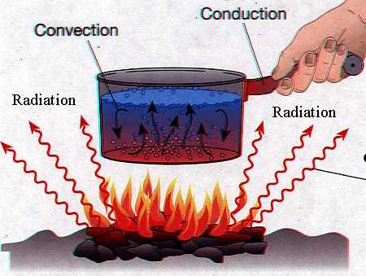
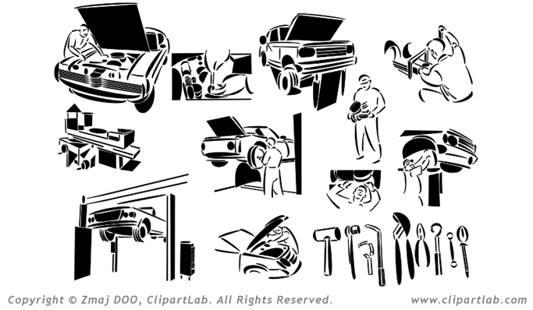
Programming for Engineers…

Slide 20
The course outcome…
By the end of the CSE101 every one of you would have your own package of:
Geometry Master
A comprehensive geometry package to formulate solutions for surface area, volume and other parameters for common shapes(circle and cylinder).

Slide 21

Get Set Go!!!
Gear up
Fasten your seat belts
Explore your logical abilities
Build your packages for future support

Slide 22
Next Class: Computer Organization
cse101@lpu.co.in

